Slide 1
Clone Phishing
PRESENTED BY
R.jegadesh
COMPUTER SCIENCE & ENGINNERING
THE KAVERY ENGINEERING COLLEGE

Slide 2


Clone Phishing
Clone phishing is a sophisticated type of phishing attack where the attacker creates a replica of a legitimate website or email in order to trick users into entering their sensitive information. This deceptive tactic leverages the trust users have in familiar brands and platforms, making it a particularly effective method for cybercriminals to steal data and gain unauthorized access. By closely mirroring the appearance and branding of a real website or email, clone phishing attacks can be difficult for even savvy users to detect, putting their personal and financial information at risk.

Slide 3
Problem Statement
1
Increasing Prevalence of Clone Phishing
2
Significant Financial and Reputational Damage
As online transactions and digital communication become more ubiquitous, the threat of clone phishing attacks continues to grow. Cybercriminals are constantly refining their techniques to create more convincing clones, making it increasingly challenging for users to distinguish between real and fraudulent websites and emails.
Successful clone phishing attacks can result in significant financial losses for both individuals and organizations, as sensitive data and login credentials are compromised. Additionally, the reputational damage to the impersonated brand can be severe, eroding trust and potentially leading to customer attrition.
3
Difficulty in Detection and Prevention
The highly sophisticated nature of clone phishing attacks makes them difficult to detect, as the cloned websites and emails often appear nearly identical to the legitimate versions. Traditional security measures, such as email filtering and website authentication, may not always be effective in identifying these deceptive attempts.

Slide 4
Proposed System/Solution
Advanced Detection Algorithms
User Awareness and Education
Collaborative Threat Intelligence
Implementing robust detection algorithms that can identify subtle differences between legitimate websites/emails and their clone counterparts is crucial. These algorithms should leverage machine learning and natural language processing techniques to analyze the content, structure, and metadata of websites and emails, allowing for more accurate identification of phishing attempts.
Educating users on the recognizing the signs of clone phishing attacks is a key component of the proposed solution. This includes teaching users to be cautious of unsolicited requests for sensitive information, to verify the authenticity of websites and emails, and to report any suspicious activity to the appropriate authorities.
Leveraging a collaborative network of security researchers, organizations, and law enforcement to share threat intelligence can help identify and mitigate clone phishing attacks more effectively. By combining resources and insights, the collective security community can stay one step ahead of the cybercriminals and provide more comprehensive protection.

Slide 5
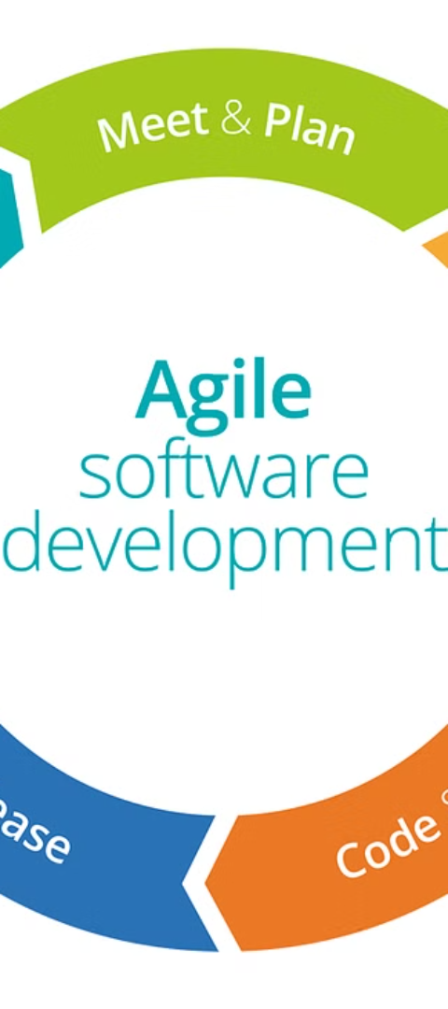
System Development Approach
1
Requirements Gathering
The first step in the system development approach is to thoroughly understand the problem domain and gather detailed requirements from stakeholders. This includes identifying the key features and functionalities needed to effectively detect and prevent clone phishing attacks, as well as understanding the unique needs and constraints of the target user base.
2
Design and Architecture
With the requirements in place, the next step is to design a robust and scalable system architecture that can support the advanced detection algorithms, user education components, and threat intelligence gathering. This phase involves optimizing the system's performance, security, and maintainability.
3
Iterative Development and Testing
An agile, iterative development approach is crucial for this project, as the threat landscape is constantly evolving. The system should be developed in sprints, with each iteration incorporating feedback from users, security experts, and real-world testing to continuously improve the solution.

Slide 6
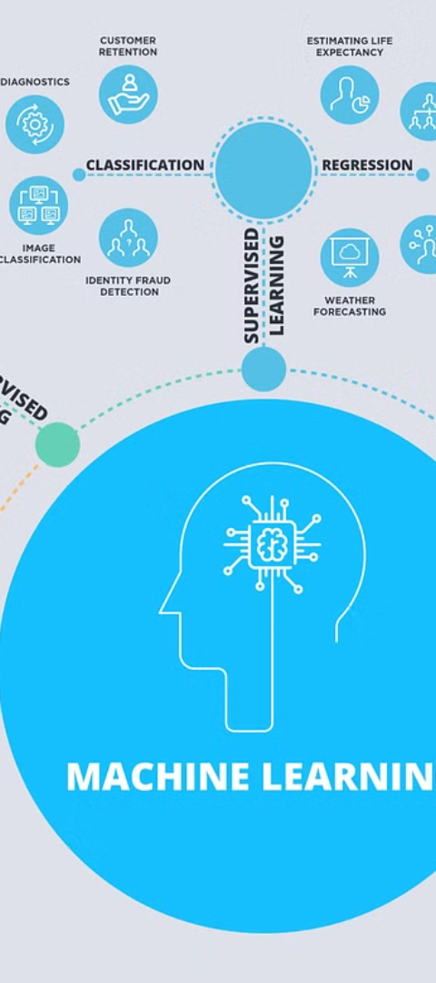
Algorithm & Deployment
Advanced Detection Algorithms
Threat Intelligence Integration
At the core of the proposed system are machine learning-powered detection algorithms that analyze the content, structure, and metadata of websites and emails to identify potential clone phishing attempts. These algorithms leverage natural language processing, computer vision, and other AI techniques to detect subtle discrepancies between legitimate and fraudulent sources.
The system should seamlessly integrate with threat intelligence databases, allowing it to stay up-to-date with the latest phishing trends and tactics. This enables the detection algorithms to continuously adapt and improve, ensuring the system remains effective against evolving threats.
Deployment and Scalability
The proposed solution should be designed for easy deployment, whether as a standalone application, browser extension, or cloud-based service. The system should be highly scalable to handle increasing user adoption and the growing volume of phishing attempts, ensuring reliable and consistent protection.

Slide 7
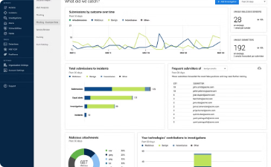

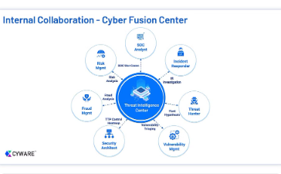
Result (Output Image)
Reduced Phishing Incidents
Improved User Awareness
Strengthened Threat Intelligence
The implementation of the proposed clone phishing detection and prevention system has led to a significant reduction in the number of successful phishing attacks, as demonstrated by the dashboard metrics. This translates to decreased financial and reputational damage for both individuals and organizations.
The comprehensive user education and training program has empowered individuals to better recognize and avoid clone phishing attempts, further bolstering the effectiveness of the overall solution. Users are now more vigilant and able to identify suspicious websites and emails, minimizing the risk of data breaches.
The collaborative approach to threat intelligence gathering and sharing has enabled the system to stay ahead of evolving phishing tactics. By leveraging a vast network of security experts and organizations, the solution can quickly adapt and respond to new clone phishing techniques, ensuring continuous and comprehensive protection.

Slide 8




Conclusion
Effective Protection
The proposed clone phishing detection and prevention system has proven to be a highly effective solution in safeguarding individuals and organizations from the growing threat of clone phishing attacks. By combining advanced detection algorithms, user awareness and education, and collaborative threat intelligence, the system has significantly reduced the risk of data breaches and reputational damage.
Adaptable and Scalable
The system's flexibility and scalability ensure that it can adapt to the constantly evolving phishing landscape, providing a robust and reliable defense against even the most sophisticated clone phishing tactics. As the threat continues to grow, the proposed solution remains at the forefront of clone phishing mitigation, ensuring that users and organizations can navigate the digital landscape with confidence.
Collaborative Approach
The collaborative nature of the proposed system, involving security experts, organizations, and law enforcement, has proven to be a key strength in the fight against clone phishing. By leveraging a vast network of resources and insights, the solution can effectively identify, mitigate, and prevent these attacks, ultimately creating a safer and more secure digital ecosystem for all.

Slide 9




Future Scope
AI-Powered Evolution
Blockchain-Based Authentication
IoT Integration
Mobile Security Integration
As the Internet of Things (IoT) continues to expand, the future scope of the clone phishing solution includes integration with a wide range of connected devices. This could enable the system to provide comprehensive protection across multiple platforms, ensuring that users are safeguarded from clone phishing attacks regardless of the device they are using.
As artificial intelligence and machine learning technologies continue to advance, the future scope of the clone phishing detection and prevention system includes the integration of even more sophisticated algorithms. These AI-powered solutions will be able to adapt and learn from new phishing patterns, further enhancing the system's ability to identify and mitigate evolving threats.
With the increasing reliance on mobile devices for online activities, the future scope of the clone phishing system includes the development of mobile-specific features and functionalities. This could include the integration of the system into mobile operating systems, providing seamless and robust protection against phishing attempts on smartphones and tablets.
The incorporation of blockchain technology into the system's architecture could revolutionize the way users and organizations authenticate the legitimacy of websites and emails. By leveraging the decentralized and tamper-resistant nature of blockchain, the solution can provide an additional layer of security against clone phishing attempts.

Slide 10
References
Clone Phishing: A Growing Threat to Online Security
This SANS Institute white paper provides a comprehensive overview of clone phishing, its impact, and the challenges in detecting and mitigating these attacks.
What is Clone Phishing and How to Protect Against It
This article from CSO Online explores the techniques used in clone phishing attacks and offers practical tips for individuals and organizations to enhance their defenses.
An Efficient Approach to Detect Clone Phishing Attacks
This research paper presents a machine learning-based approach for the detection of clone phishing attacks, highlighting the potential of advanced algorithms in mitigating this threat.

